Slide 1
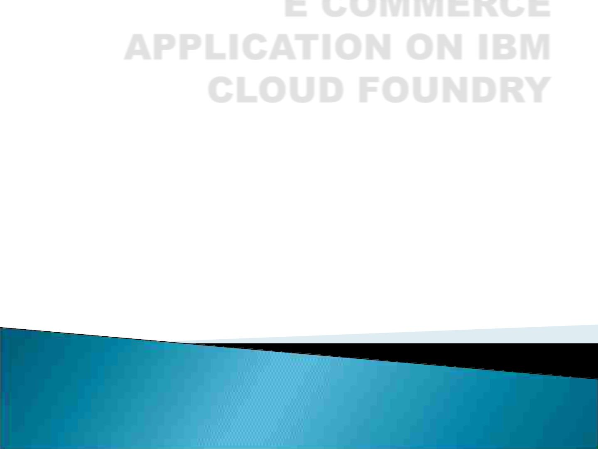
E COMMERCE
APPLICATION ON IBM
CLOUD FOUNDRY
COLLEGE: UNITED INSTITUTE OF TECHNOLOGY COLLEGE
CODE :7145
BATCHMATES: HARINI R
MAHALAKSHMI K
BHUVANESHWARI R
NAVEEN KUMAR S
SHONE V SAMUEL
UMA SHANKAR S
GUIDE:Mrs.NISHANTHI
DOMAIN:CLOUD COMPUTING

Slide 2

Problem Description
Build an artisians e-commerce
platform using IBM cloud foundry
connect skilled artisians with a global
audience.showcase handmade
products,from exquisite jewelry to
artisians homedecor.implement secure
shopping carts,smooth payments
gateways,and an intuitive checkout
process.nurture creativity and support
small business thought on artisians
dream market place

Slide 3
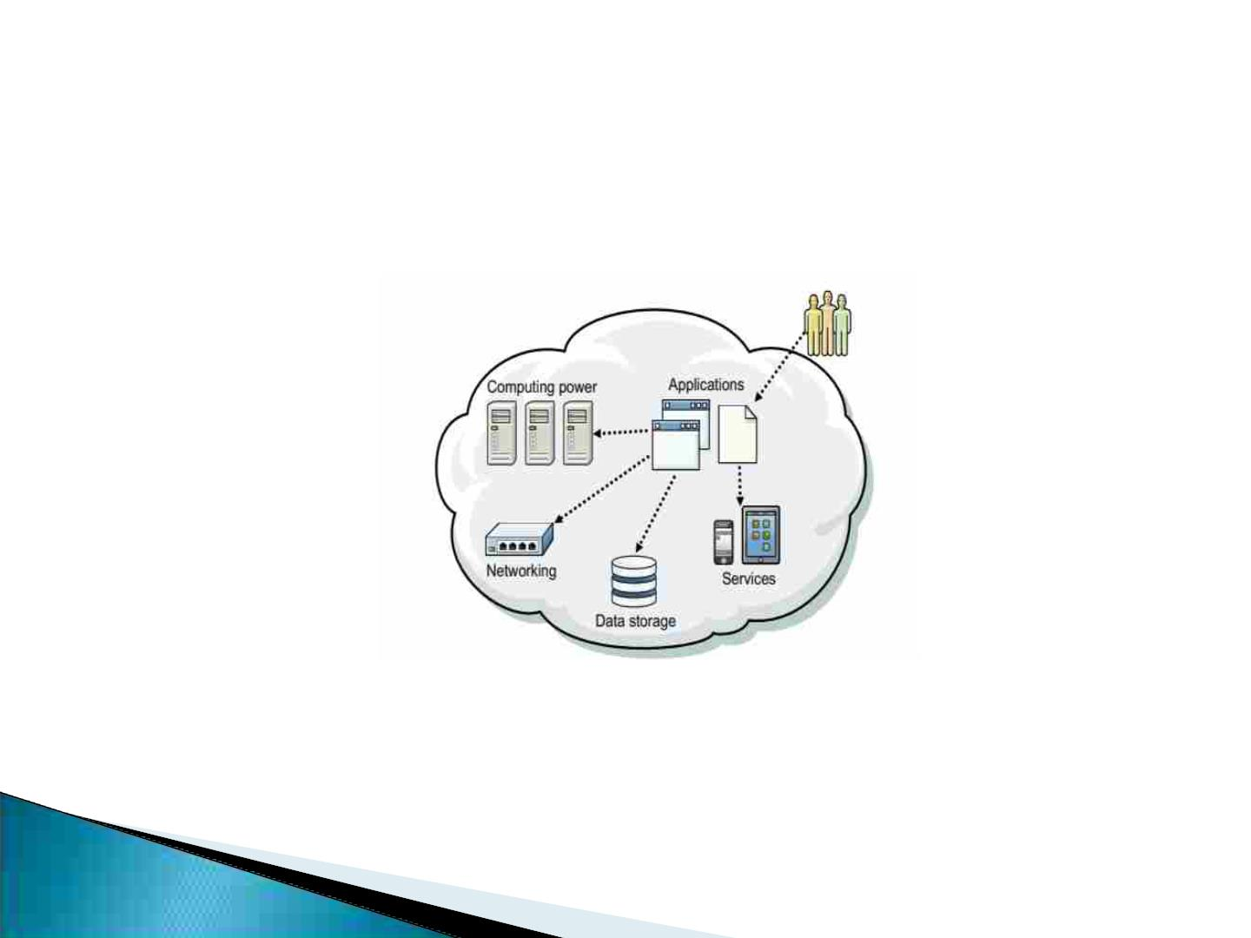
Application overview on cloud foundry
“Cloud Computing is a model for enabling convenient, on-demand
network access to a shared pool of configurable computing resources that
can be rapidly provisioned and released with minimal management effort
or service provider interaction.”
The term cloud is used as a metaphor for the internet and a virtualized
set of hardware resources. The term also is an abstraction for the
complex infrastructure it conceals. The generally accepted definition of
cloud computing comes from the National Institute of Standards and
Technology (NIST).

Slide 4
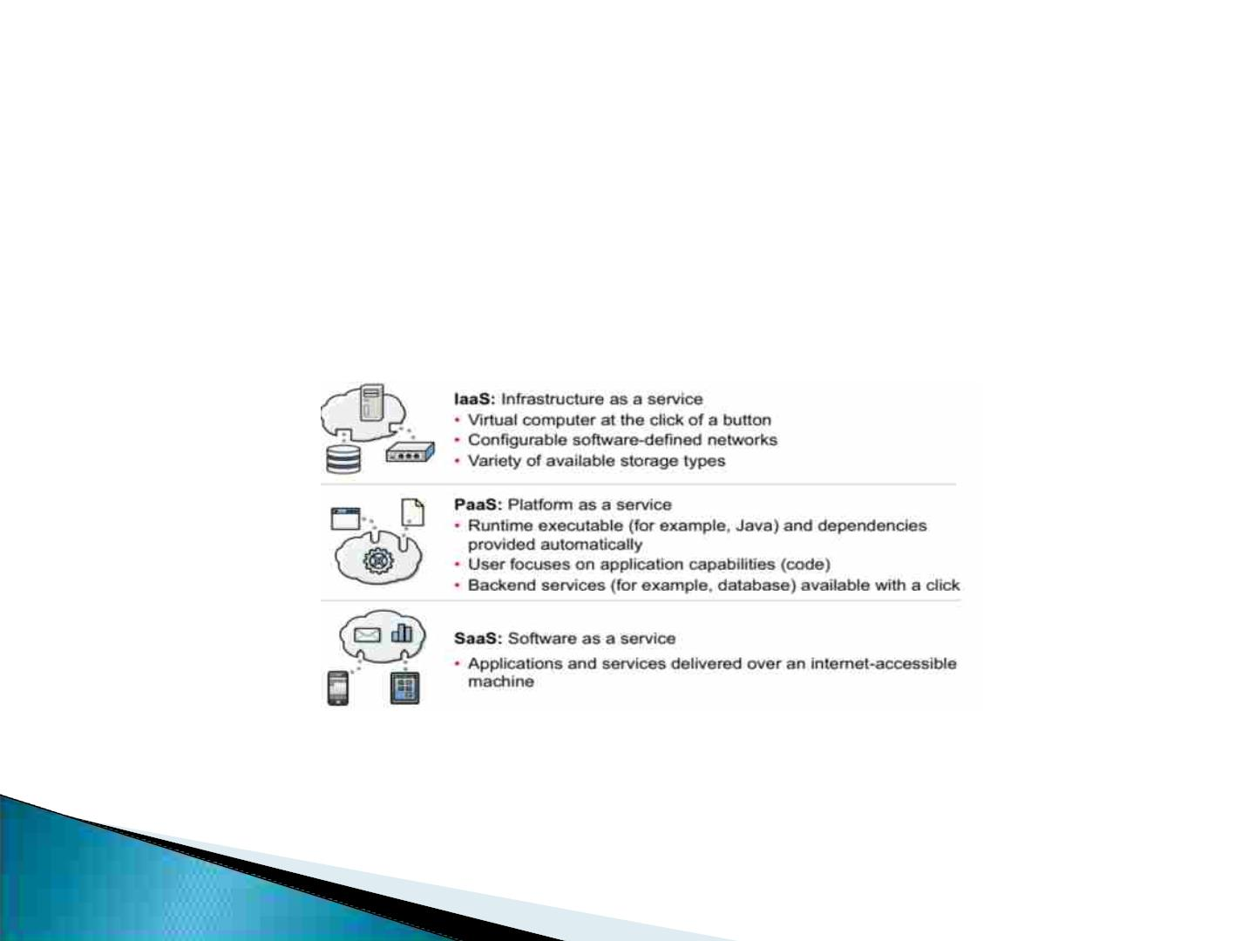
Factors contributing to growth of cloud
Applications with a short lead time to delivery
• Developers expect to have programming language options and interact with
predefined services
• Modern applications must be able to scale and be managed dynamically
• Developers expect the pay-as-you-go utility computing billing method
Cloud service models

Slide 5
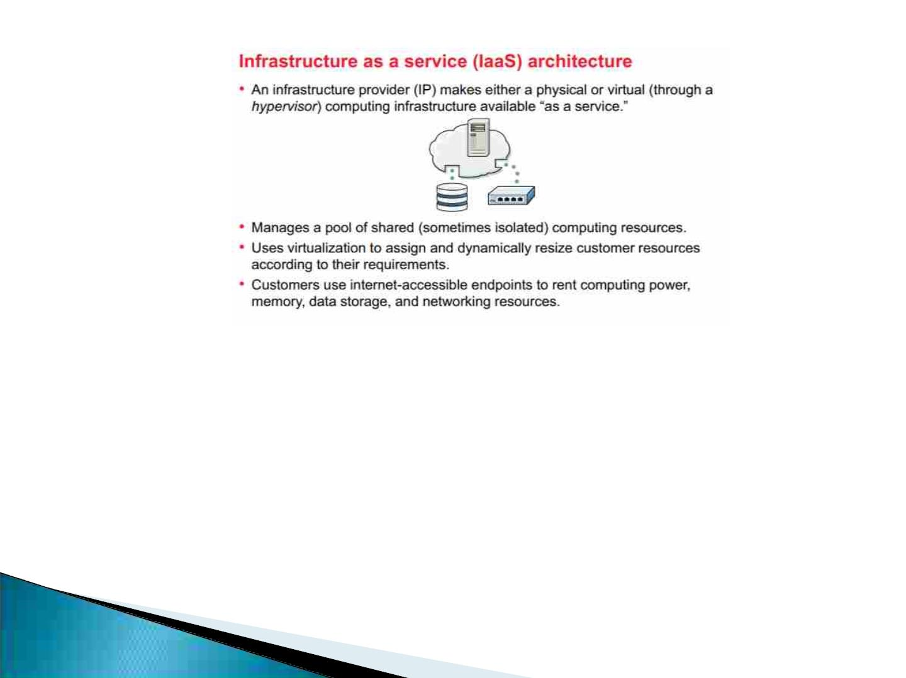
Infrastructure as a service architecture
Cloud and mobile computing are changing traditional IT
• Cloud computing is a disruptive change in the IT industry:
• New computing model, different from traditional IT computing models
• Enables ubiquitous computing
• Mobile device access
• Demand for dynamic and responsive IT infrastructure requires new
methodologies:
• Development processes
• Application design
• Development tools

Slide 6
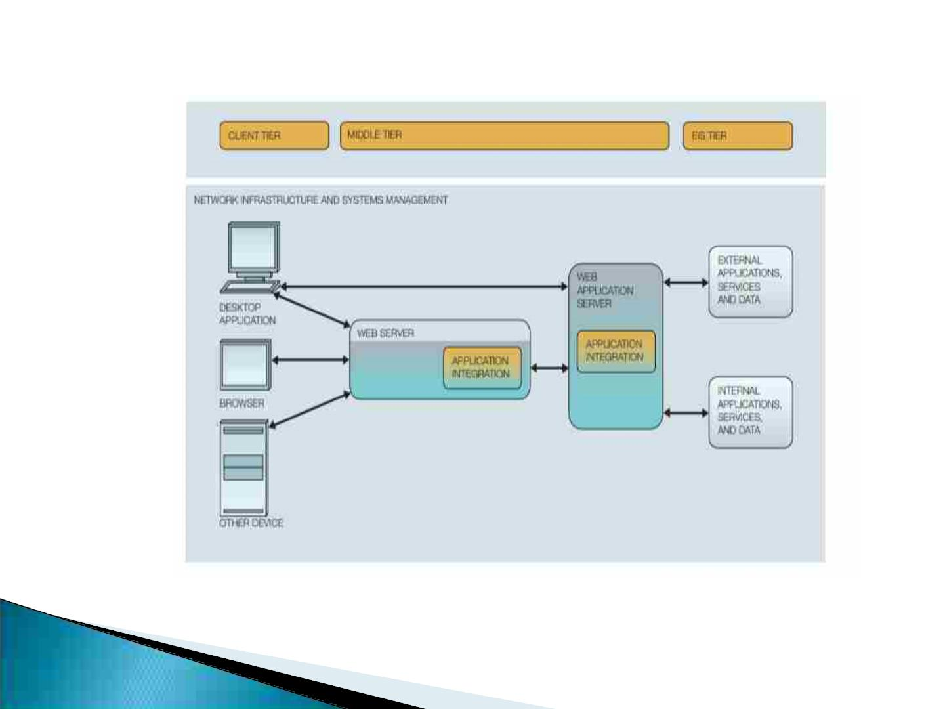
IBM Application Framework for e-business

Slide 7
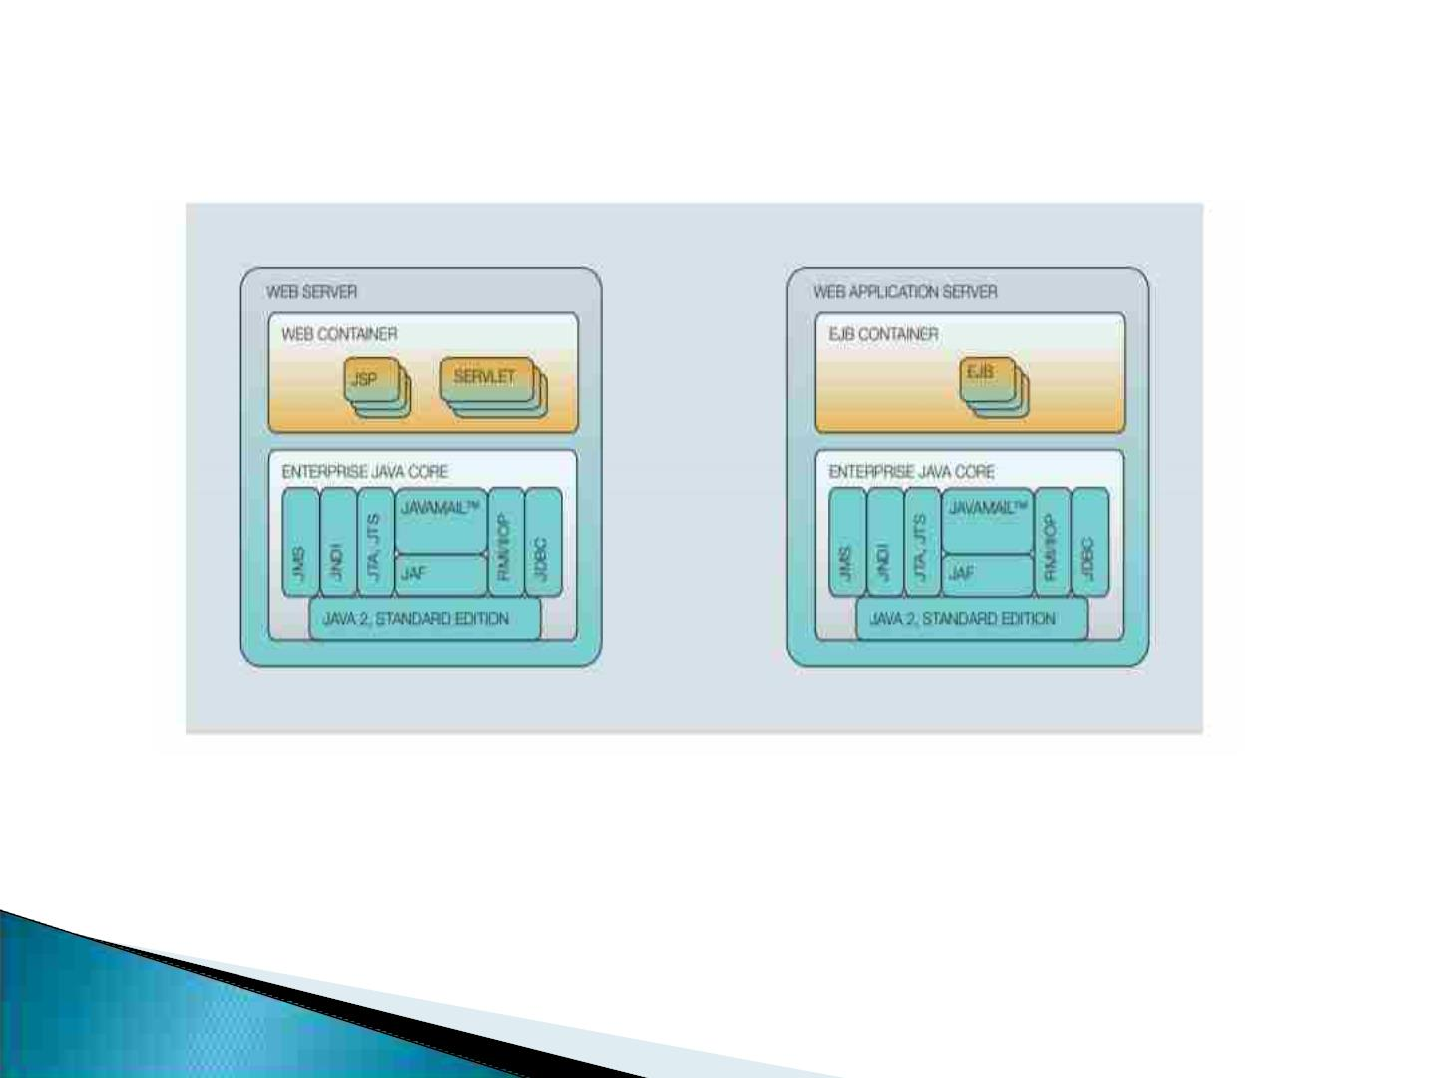
Web server and Web application server

Slide 8
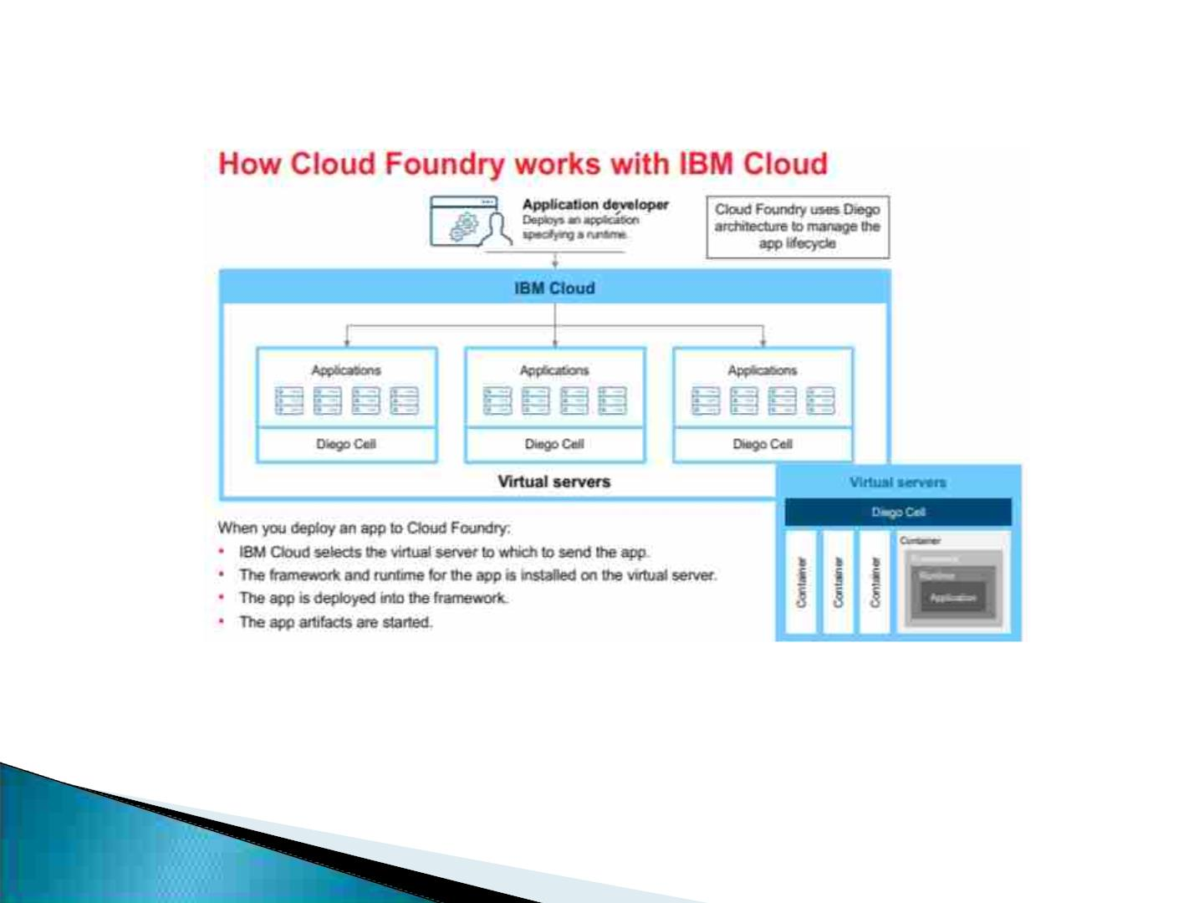
Cloud Foundry works with IBM Cloud

Slide 9
Application Deployment
When you create an app and deploy it to Cloud Foundry, the IBM Cloud
environment determines an appropriate virtual server to which to send the
app.
The virtual server is chosen based on several factors, including the
hardware/file system that is required by the app, and the load that is on the
machine.
After a virtual server is chosen, the following tasks are completed: An
application manager on the virtual server installs the appropriate framework
and runtime for the app.
The app is deployed into that framework. When the deployment completes,
the application artifacts are started.
Virtual Servers
Each virtual server has multiple apps deployed on it. In each virtual server,
an application manager communicates with the rest of the IBM Cloud
infrastructure and manages the apps that are deployed to this virtual server.
Each virtual server features containers that are used to separate and protect
apps. In each container, IBM Cloud installs the appropriate framework and
runtime that are required for each app.

Slide 10
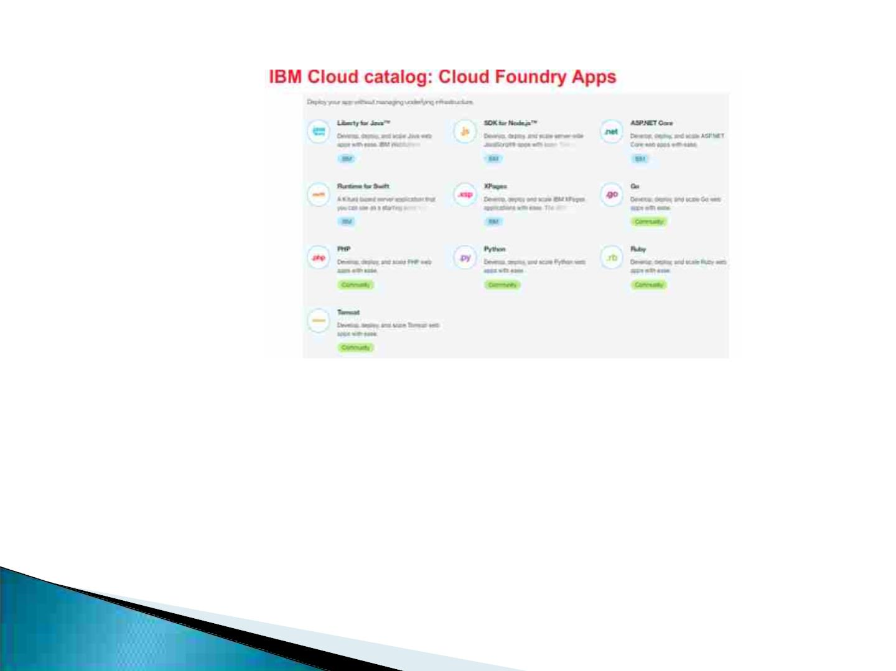
IBM Cloud catalog: Cloud Foundry Apps
IBM Cloud Functions has the following benefits:
Cost-Effective Computing: Pay only for the exact time your actions run,
down to one-tenth of a second; no memory, no cost.
Automatically scale: Run your action thousands of times in a fraction of a
second, or once a week. Action instances scale to meet demand, then
disappear. Easy integration: Trigger your actions from events in your
favorite services, or directly by using REST API.

Slide 11
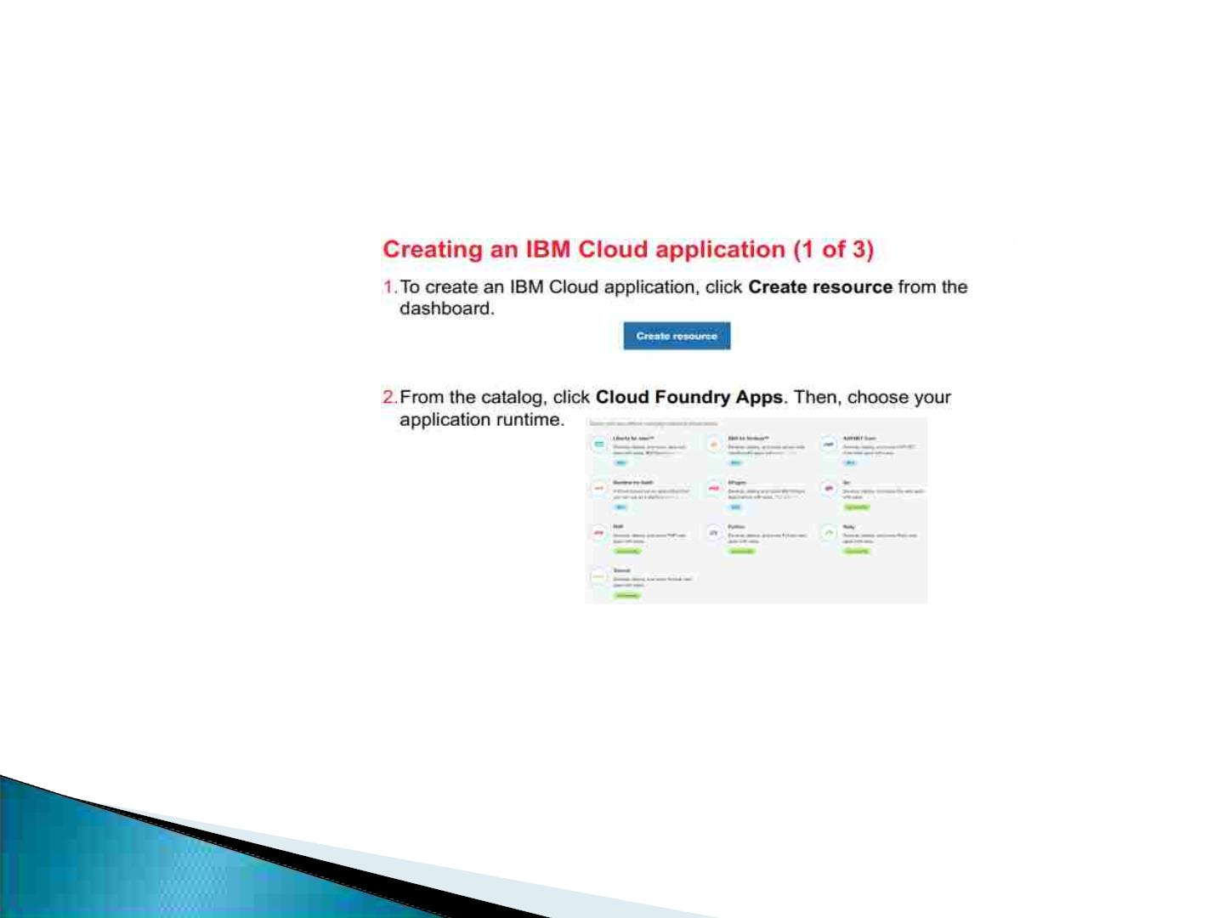
Creating an IBM Cloud application (1 of 3)
The following runtimes are now available as Cloud Foundry Apps:
Liberty for Java
SDK for Node.js
ASP.NET Core
Runtime for Swift Xpages
Go PHP Python Ruby Tomcat

Slide 12
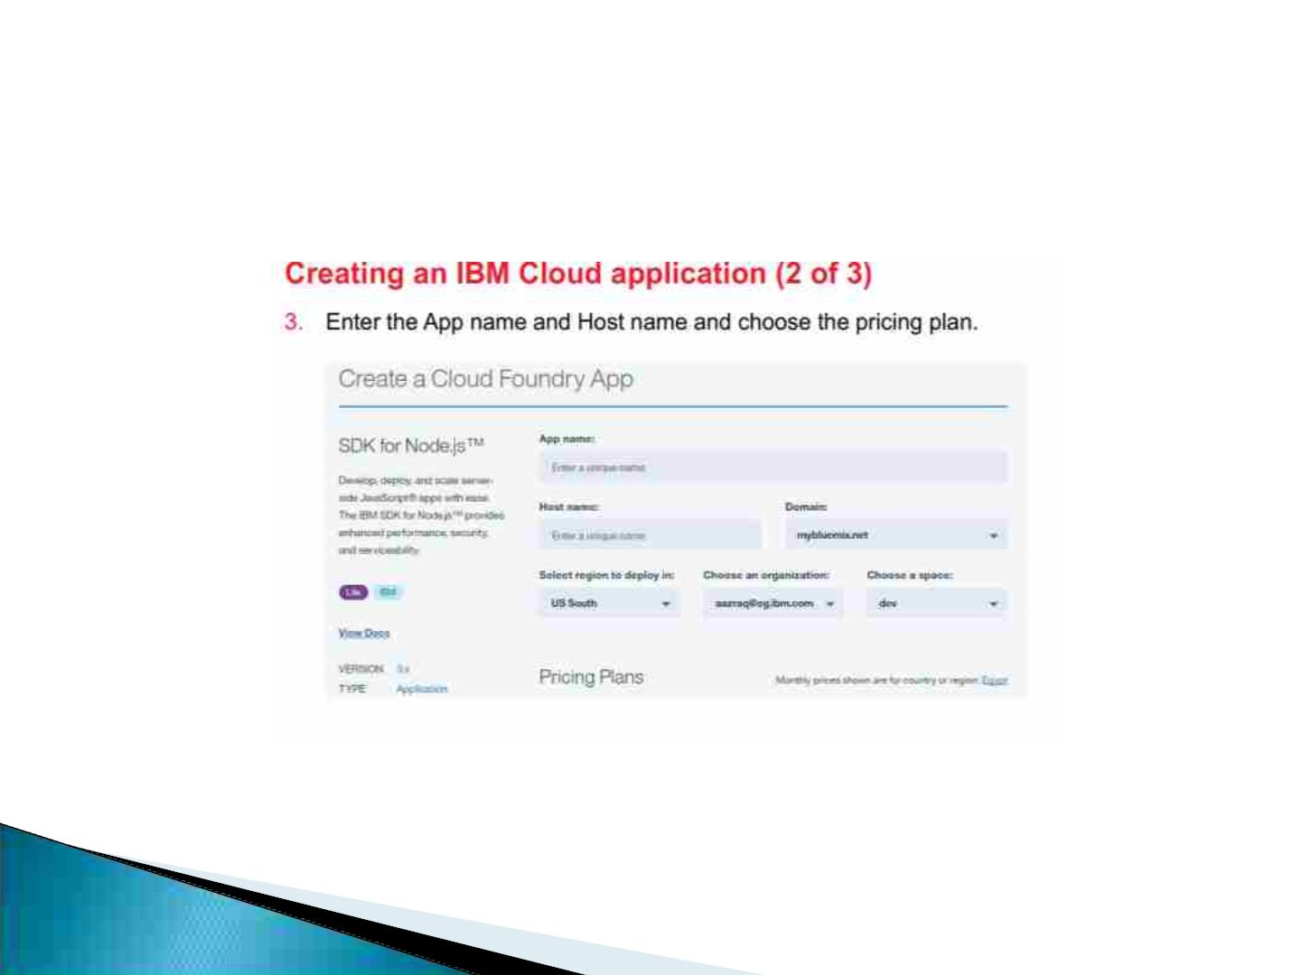
Creating an IBM Cloud application (2 of 3)

Slide 13
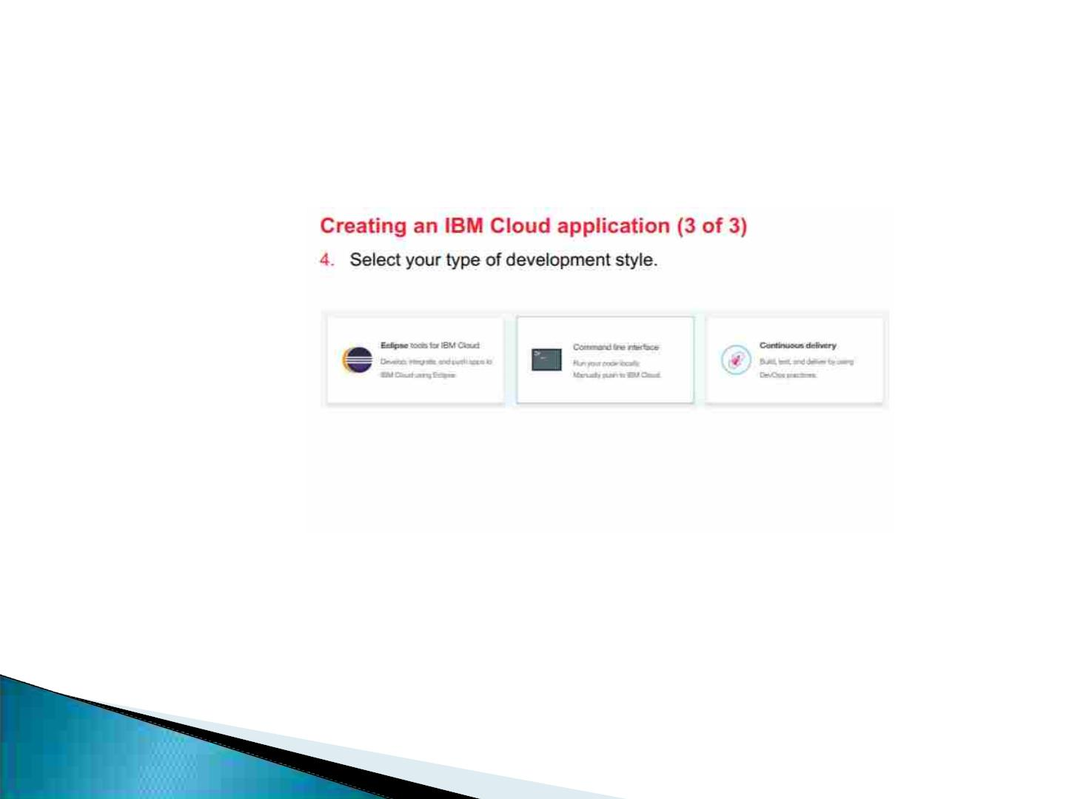
Creating an IBM Cloud application (3 of 3)
Next, select your development style. You can perform the following
tasks:
Download Eclipse Tools for IBM Cloud, which allows you to work on
Cloud Foundry applications within the Eclipse integrated development
environment.
Edit your app in your preferred text editor and use the IBM Cloud
command line to deploy.
Use IBM Cloud DevOps Services to deploy your application with a
completely web-based

